Slide 1
Human Attention in Visual Question Answering:
Do Humans and Deep Networks Look at the Same Regions?
Abhishek Das, Harsh Agrawal, C. Lawrence Zitnick,
Devi Parikh, Dhruv Batra
EMNLP2016
Presented by : Aditya Jain 2016CS10335

Slide 2
RoadMap
Motivation
Methods and Observations
Conclusion

Slide 3
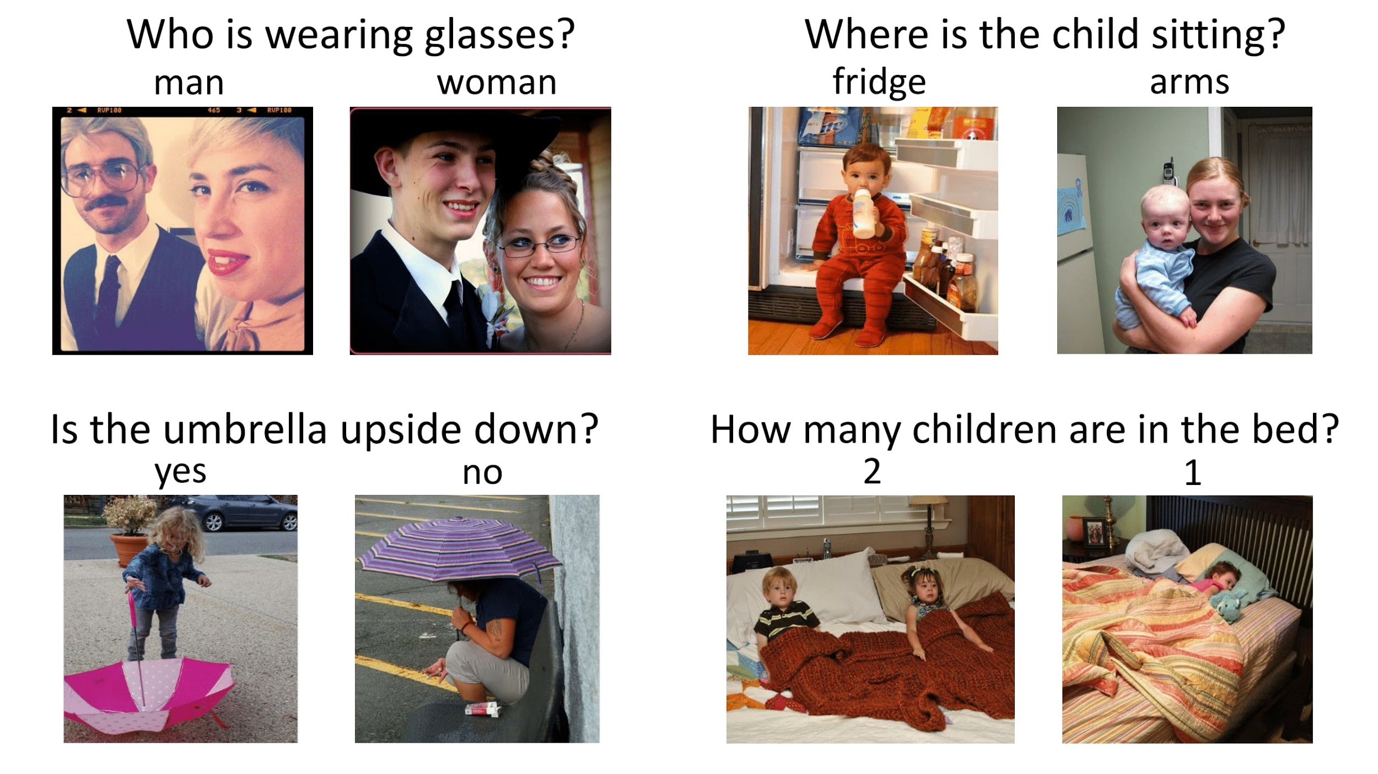
Motivation
What is Visual Question Answering

Slide 4

Motivation
What helps us (humans) to answer these questions more precisely ?

Slide 5
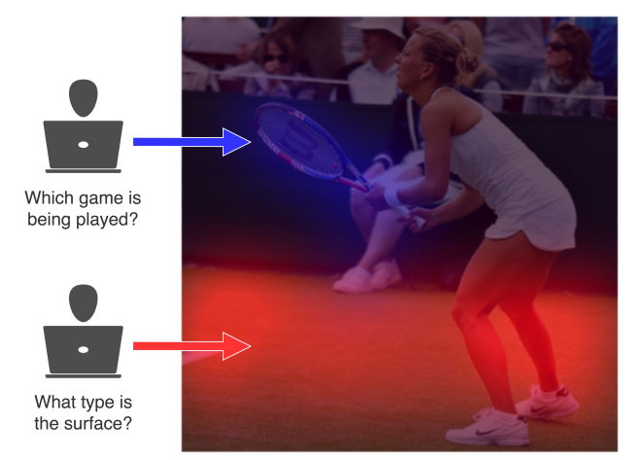
What does attention mean in the context of VQA?

Slide 6
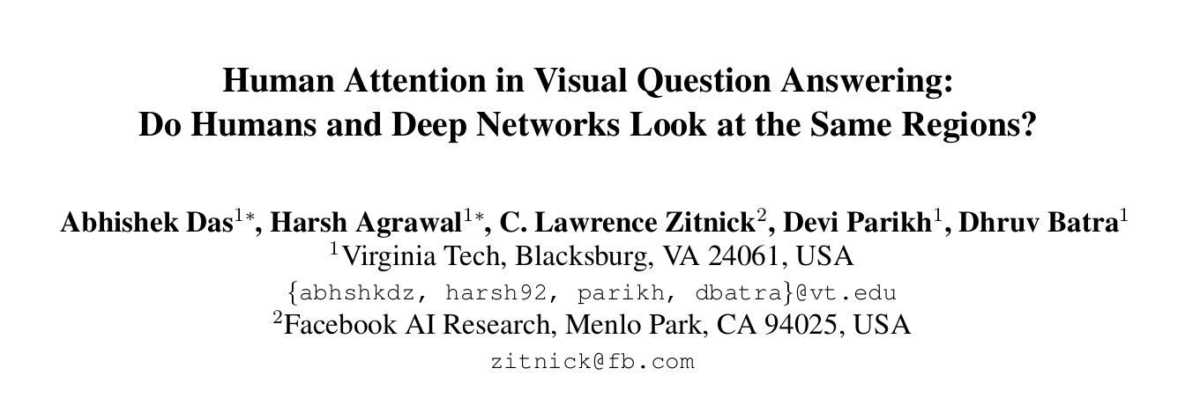
Motivation
Inspired by Humans a new trend emerged in building computation models for attention
Successful in tasks such as machine translation , object recognition , image captioning and visual question answering
BUT...

Slide 7
Motivation : Principle Questions
1) Which image regions do humans choose to look at in order to answer questions about images?
2) Do deep VQA models with attention mechanisms attend to the same regions as humans?

Slide 8
VQA Models
Stacked Attention Networks (SAN) proposed by Zichao Yang at CoRR 2015
Hierarchical Co-Attention Network (top entry in VQA challenge 1)
Both networks are unsupervised where “attention” is simply an intermediate variable (a spatial distribution) that is produced by the model to optimize downstream loss (VQA cross-entropy)

Slide 9
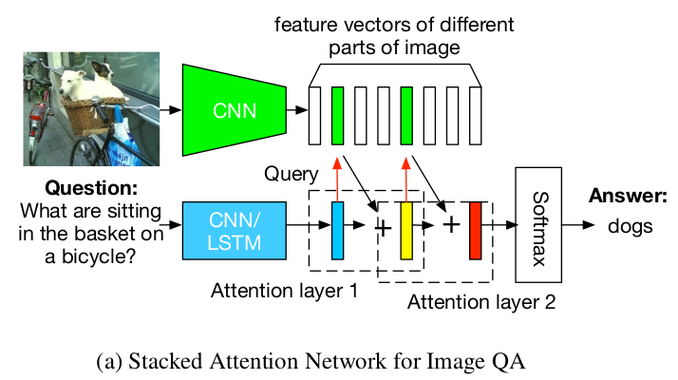
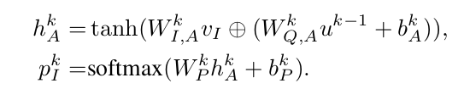
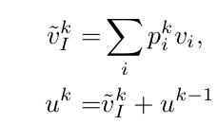
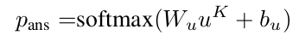
Brief Overview: Stacked Attention Networks(SAN)

Slide 10
Brief Overview: Stacked Attention Networks(SAN)
Q(t)
+
Q(t+1)
P(t)
*
I
Q(t) : Query Vector at level t
I : Image Vector
P(t) : Attention vector for level t
Q(t+1): Refined Vector at level t

Slide 11
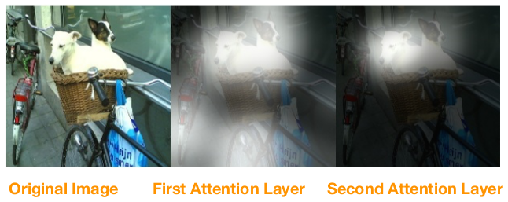
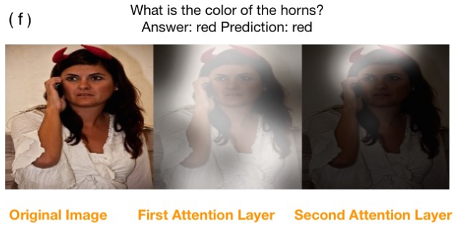
Visualizing Stacked Attention:

Slide 12
Novel Ideas of HieCoAtt Network
Attention given to both question and image termed as co-attention
Question encodings are made in hierarchical fashion consisting of words , phrases and full questions

Slide 13
DataSet
large-scale VQA dataset (Antol et al., 2015)
248349 Train images with question-answer pairs
121512 Test images with question-answer pairs
Comprises of Yes/No , counting and word problems
But no dataset with a measure of human attention

Slide 14
Methods and Experiments
Create a Dataset VQA-HAT (Human - ATtention) using game-inspired novel interfaces.
Compare maps generated by VQA models against human attention

Slide 15
VQA-HAT (Human ATtention) Dataset
Using game-inspired novel interfaces for conducting large-scale human studies on AMT (Amazon Mechanical Turk)
Interface :- “De-Blurring” exercise for answering visual questions

Slide 16
Two factors that affect the attention
Exploration
Exploitation

Slide 17
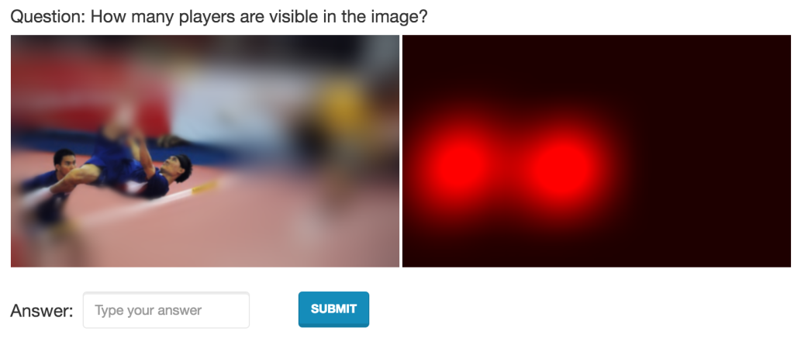
Blurred Image without Answer
ex-ploratory attention
Incomplete attention maps
Incorrect answers (mostly counting and binary)

Slide 18
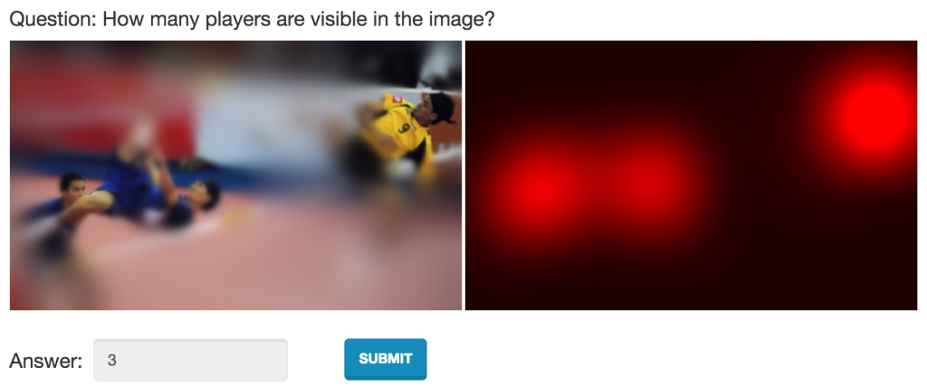
Blurred Image with Answer
Since answer is known regions are explored till the answer region is found

Slide 19
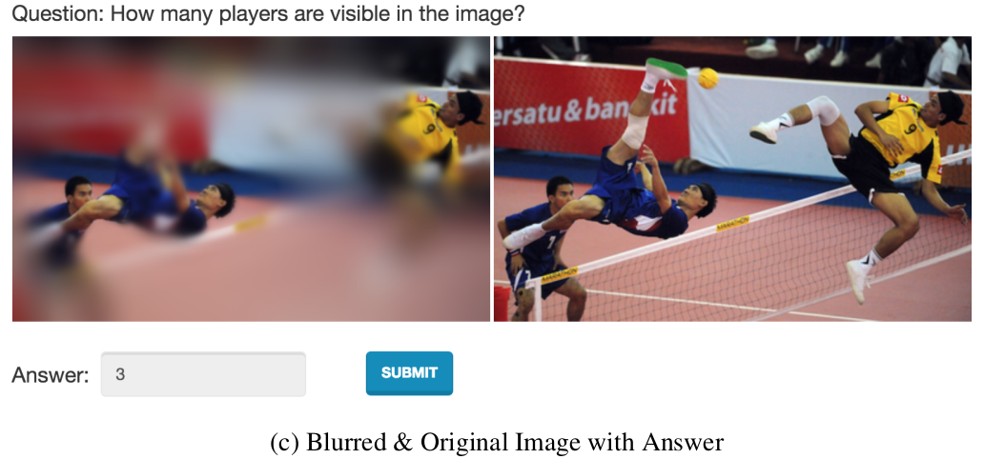
Blurred and Original Image with Answer
Encourages exploitation instead of exploration
Most accurate attention map

Slide 20
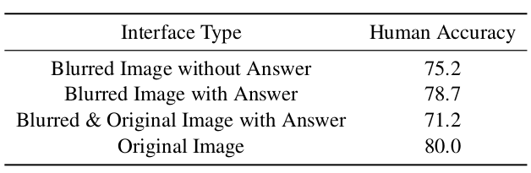
Dataset Evaluation
Second set of subjects asked to answer the question given the deblurred images of the first subjects
Blurred Image with Answer gives the best accuracy as a result of perfect combination of exploitation and exploration

Slide 21
Dataset statistics
Total human attention maps collected :
58475 train (out of 248349 total)
1374 val (out of 121512 total)
Conducted approximately 20000 Human Intelligence Tasks (HITs) on AMT, among 800 unique workers

Slide 22
One more baseline : Judd dataset
These maps are task independent human attention saliency maps
Eye tracking data to study natural visual exploration

Slide 23
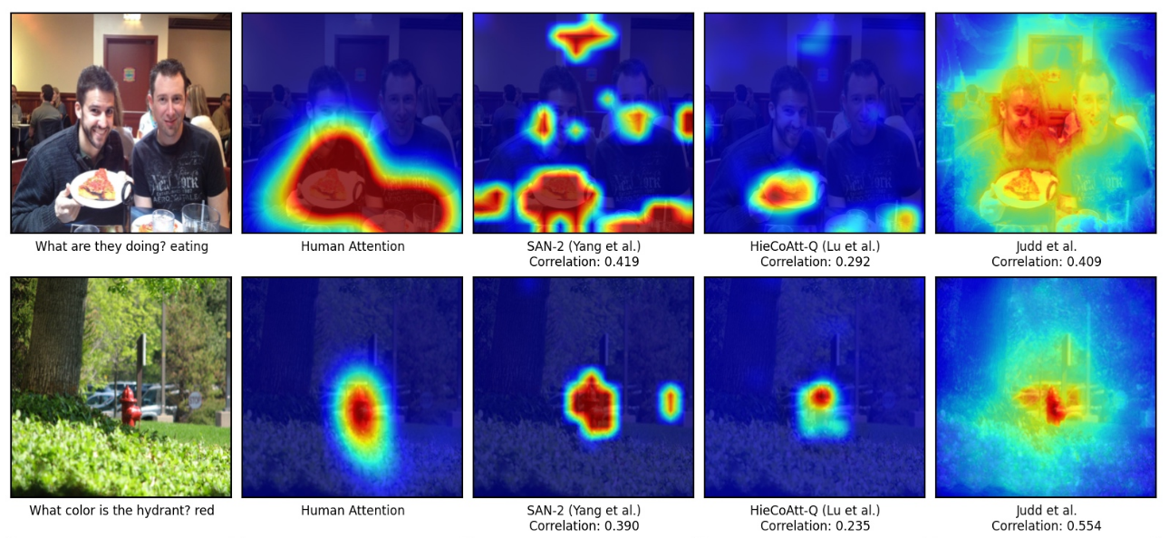
Comparison

Slide 24
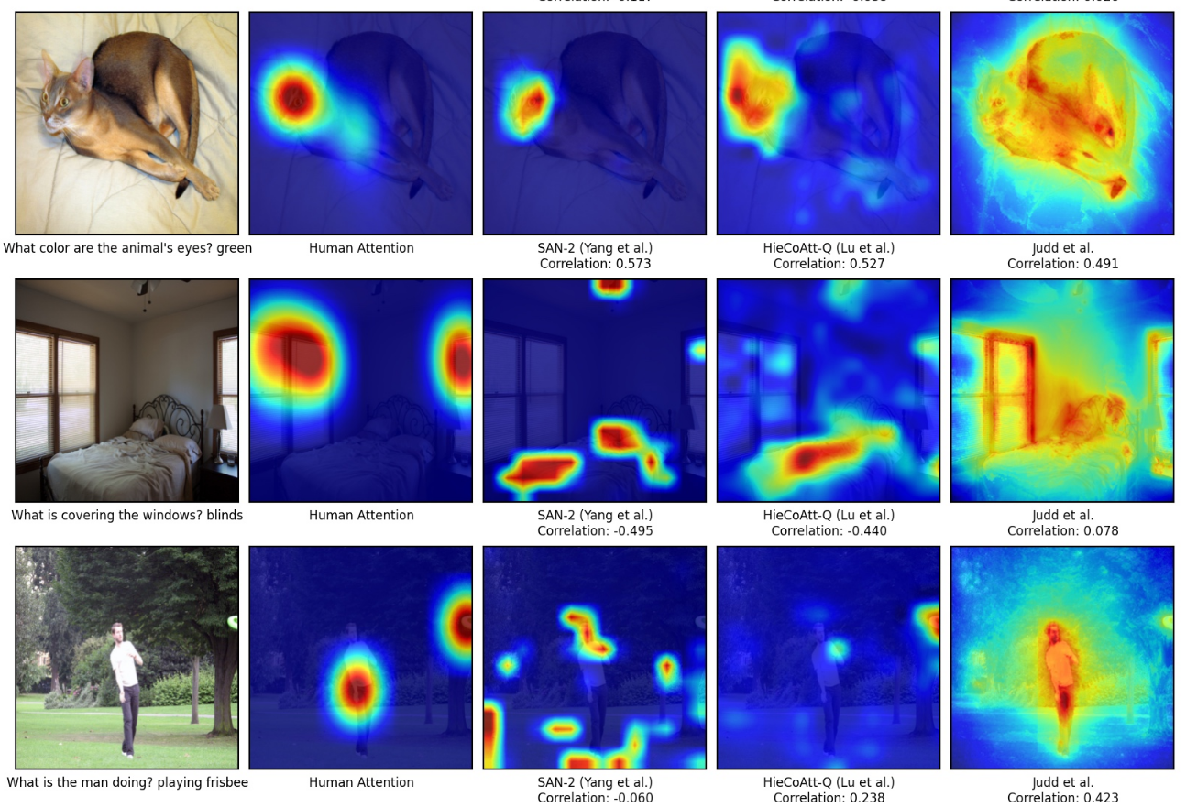

Slide 25
Comparison Metric: Rank Correlation
Machine -Generated Attention Map
14 14
Rank pixels acc. to spatial att.
Compute Correlation
Human Generated Attention Map
14 14
Rank pixels acc. To spatial att.

Slide 26
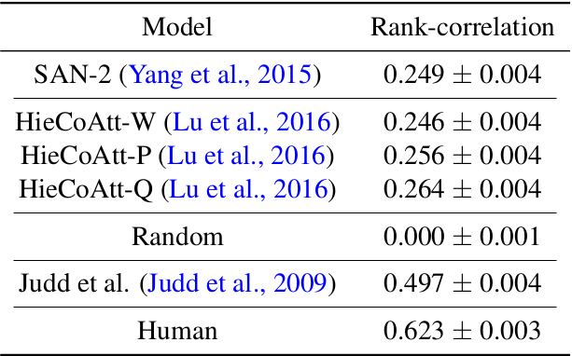
Rank Correlation Results
Both models are positively correlated
But not as strongly as task independent Judd saliency maps

Slide 27
Why is task-independet model showing better results?
Center Bias

Slide 28
Eliminate effect of center bias
Remove maps having positive correlation with center attention map
After recomputing the rank correlation the results were ...

Slide 29
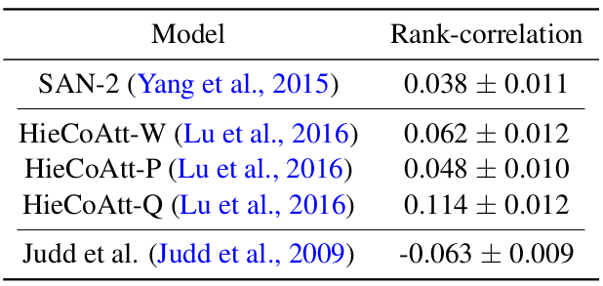
Results after removing centre bias

Slide 30
Two major take-away messages
current VQA attention models do not seem to be ‘looking’ at the same regions as humans to produce an answer
As the models become better at accuracy the more they correlate with humans in terms of where they look
58.9% SAN → 62.1% HieCoAtt (VQA dataset)

Slide 31
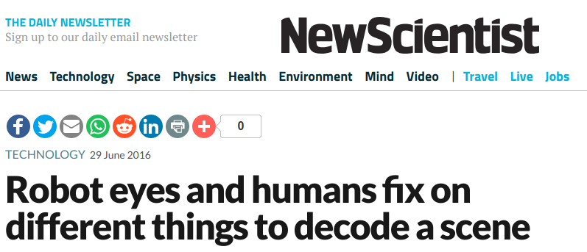
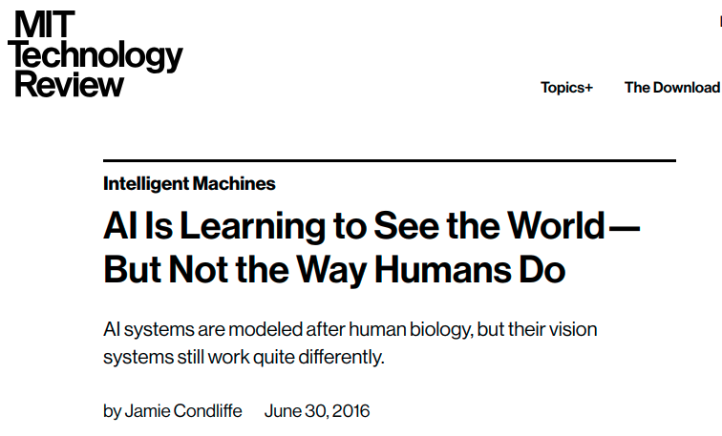
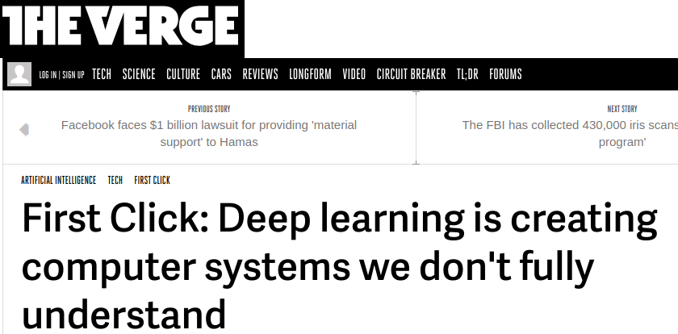
And the Attention this paper got ;)

Slide 32
Thanks !!!
References:
[Judd et al.2009] Tilke Judd, Krista Ehinger, Frédo Durand, and Antonio Torralba. 2009. Learning to predict where humans look. In ICCV.
[Lu et al.2016] J. Lu, J. Yang, D. Batra, and D. Parikh 2016. Hierarchical Co-Attention for Visual Question Answering. ArXiv e-prints, May
[Yang et al.2015] Zichao Yang, Xiaodong He, Jianfeng Gao, Li Deng, and Alexander J. Smola. 2015 Stacked attention networks for image question answering. CoRR,abs/1511.02274

